Slide 1
MySQL Protocol
昌維
changwei1006@gmail.com
https://changwei.me
2021-04-13

Slide 2
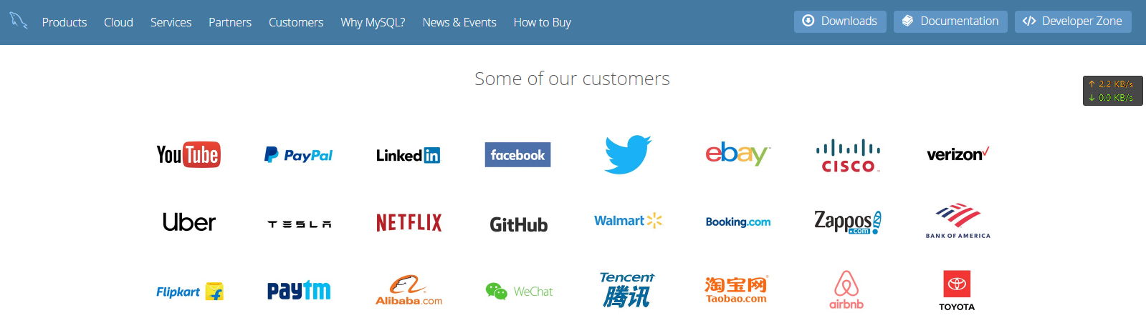
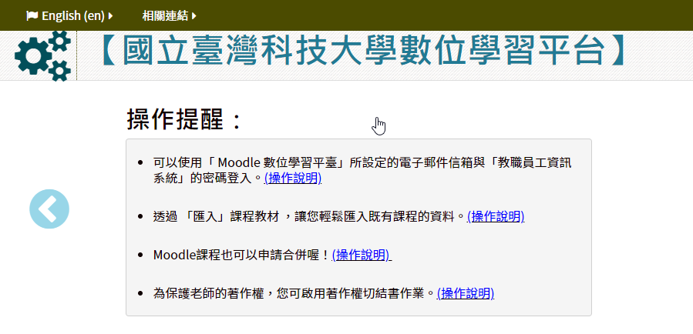
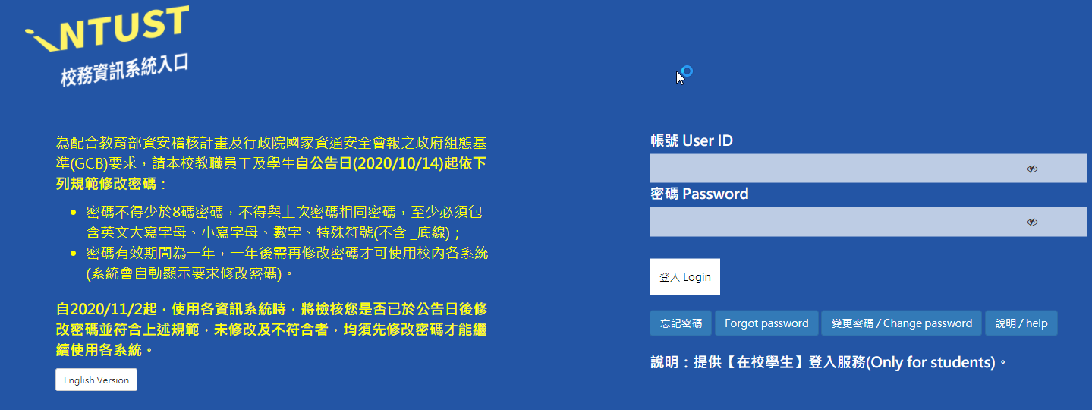
Who are using the MySQL?

Slide 3
MySQL protocol and HandshakeV10
HandshakeV10 is a handshake protocol for MySQL initiate communication session between the server and client. It is used by MySQL 4.x, 5.x and later version.
You can read more about this protocol at the link below.
https://dev.mysql.com/doc/dev/mysql-server/8.0.11/page_protocol_connection_phase_packets_protocol_handshake_v10.html
https://dev.mysql.com/doc/internals/en/client-server-protocol.html

Slide 4
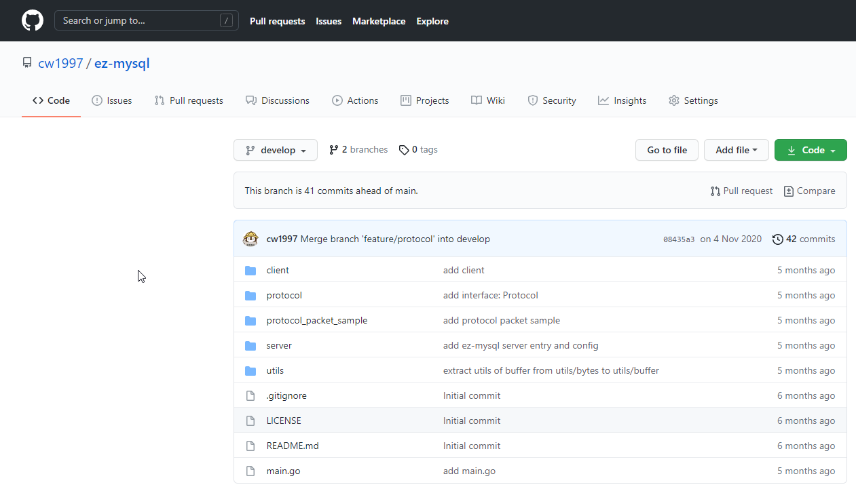

Source Code
https://github.com/cw1997/ez-mysql/tree/develop

Slide 5

Toolkit
Wireshark with Winpcap or namp
Golang
Scapy
You can download the example pcap file to analysis the MySQL protocol at the link below.
https://github.com/cw1997/ez-mysql/tree/develop/protocol_packet_sample

Slide 6
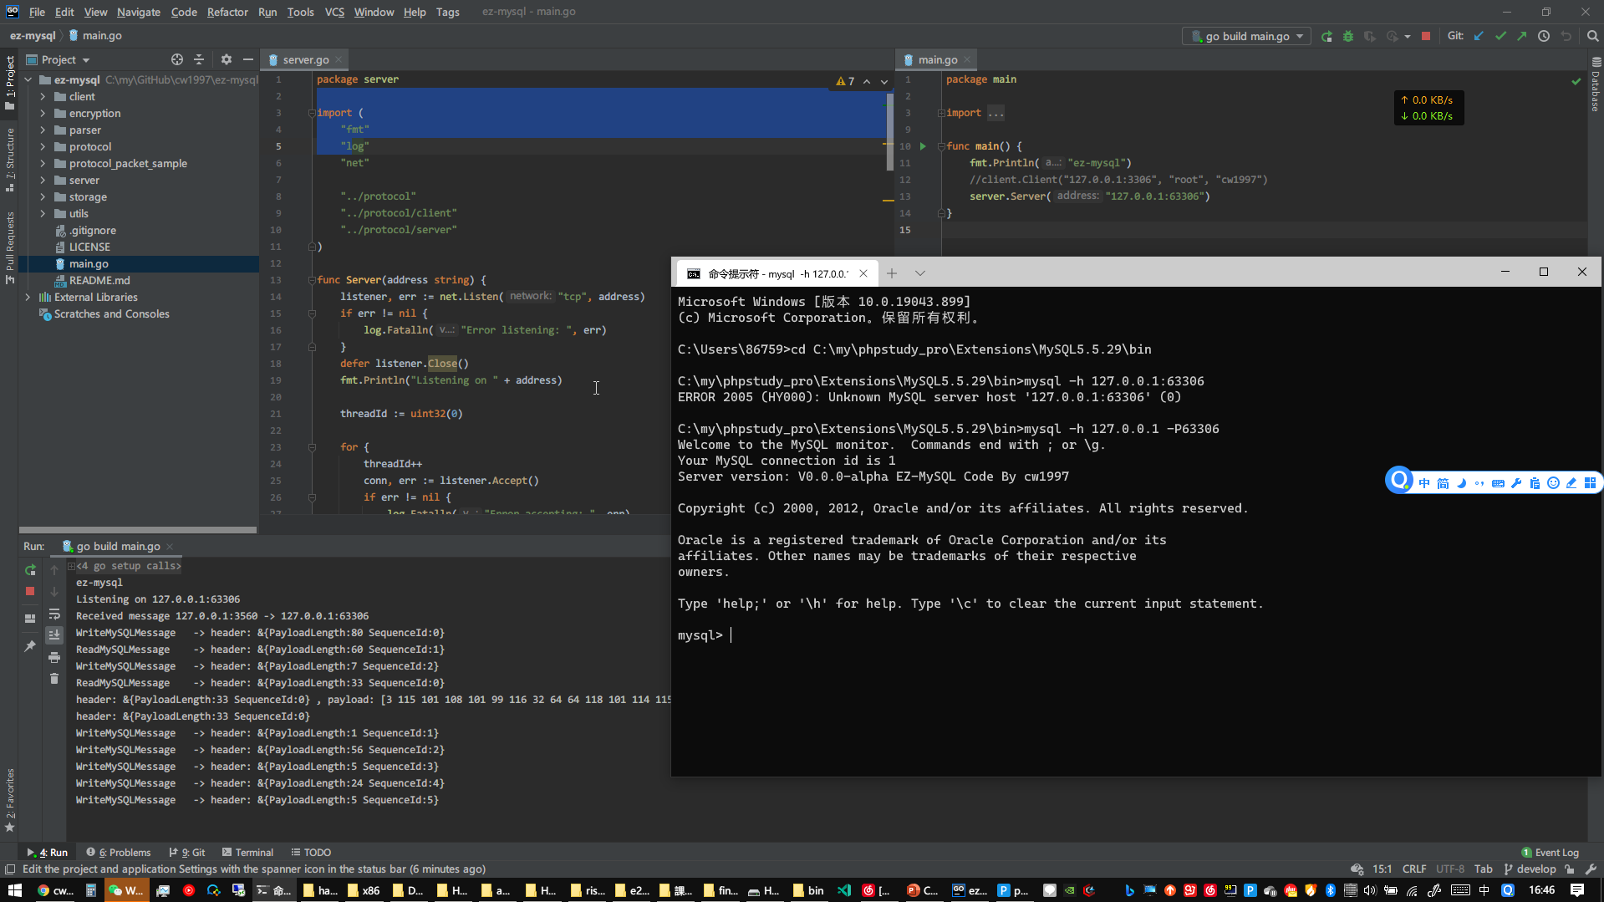
Run Server

Slide 7
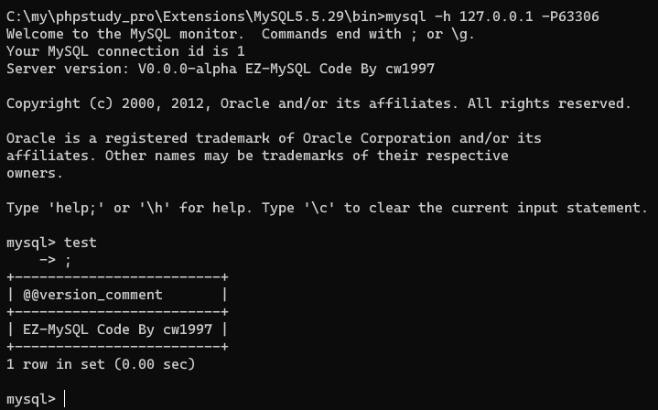
Communicate by MySQL Protocol
See the ‘Server version’

Slide 8
Handshake flowchart
The client actively connects to the server
The client usually uses the TCP protocol at port 3306 to connect to the server
Server return a greeting packet
Protocol Version
Client request login
Username
MySQL Server Version
Thread ID (client connection id)
Salt and extended-salt for authentication
Server Capabilities, Language and Status
Authentication plugin name length
Authentication plugin name
Password (hashed by salt from server)
Max packet number
Client Capabilities
Charset code(usually use utf8, the value is 0x33)
Client auth plugin name (require to negotiated)
Connection Attributes (including length, OS, client name, PID(Process ID), thread, CPU platform, client version)
Server return OK packet if password is correct
Client send SQL statement

Slide 9
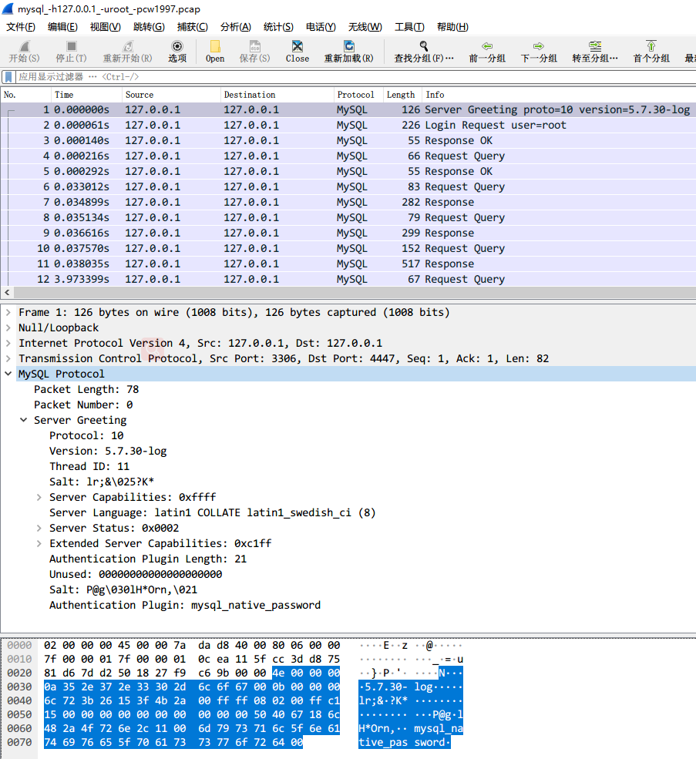
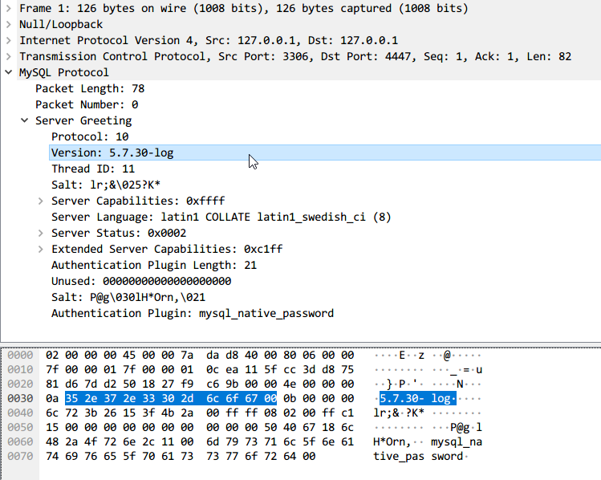
Step 1: Server Send Server Greeting

Slide 10
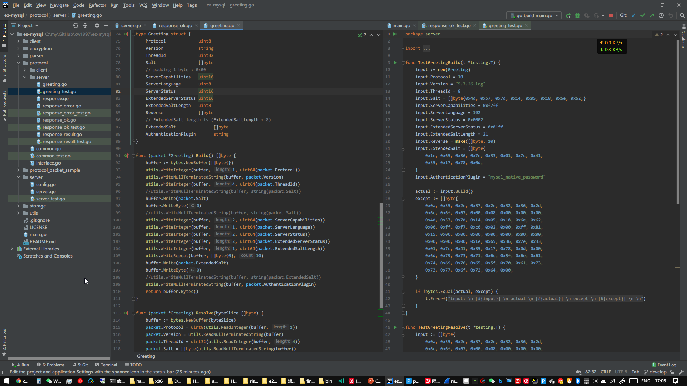
Server Greeting source code with unit test

Slide 11
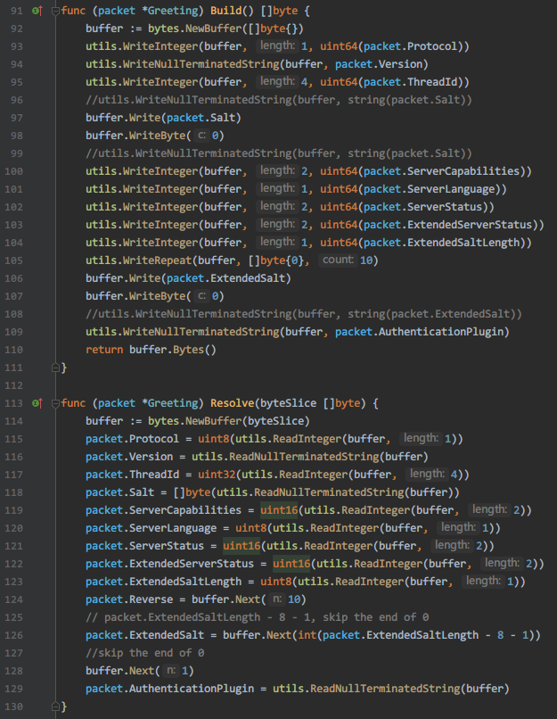
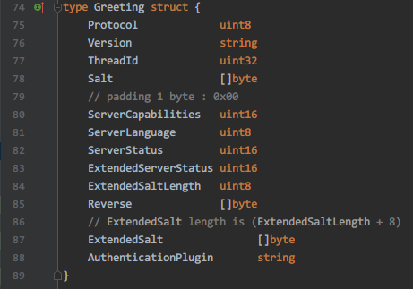
Server Greeting structure code

Slide 12
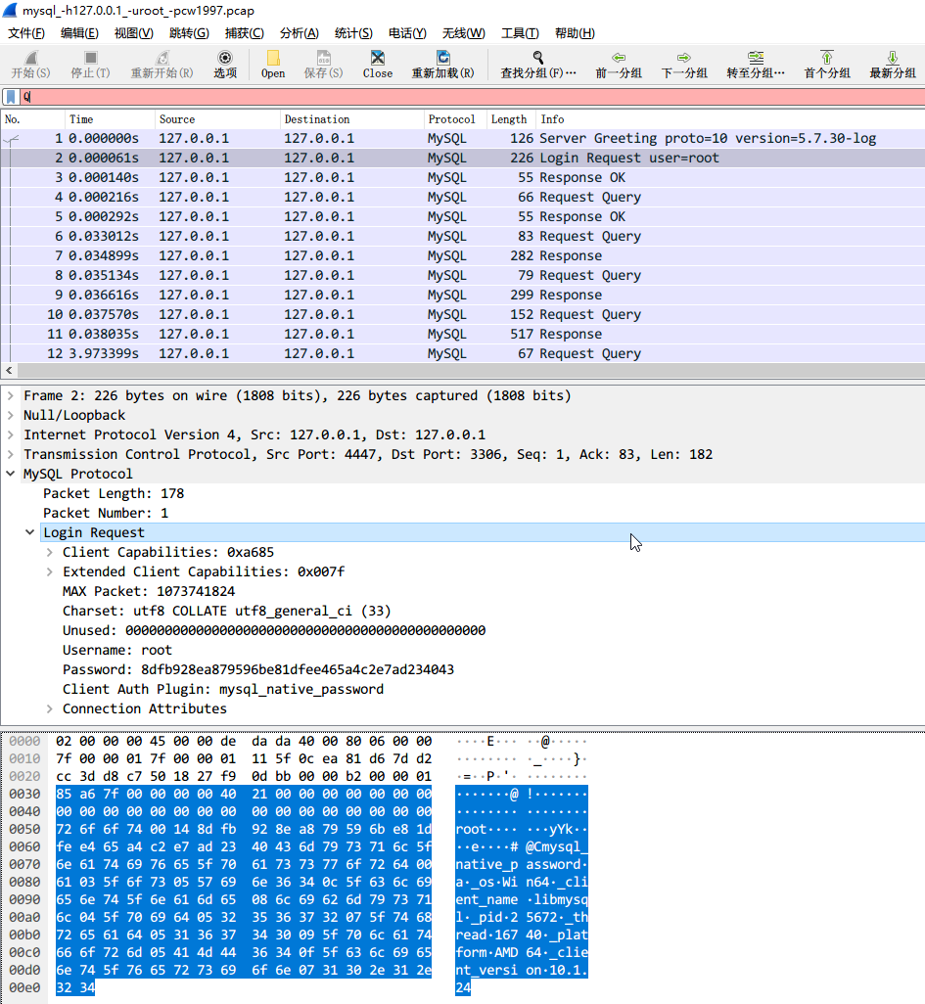
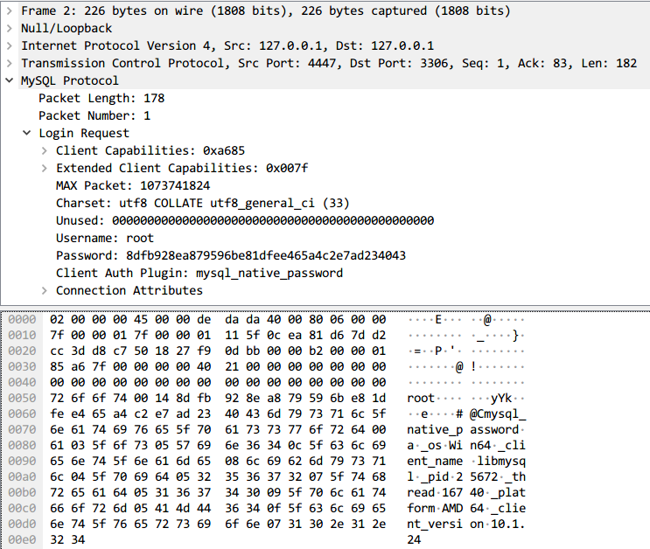
Step 2: Client send Login Request

Slide 13
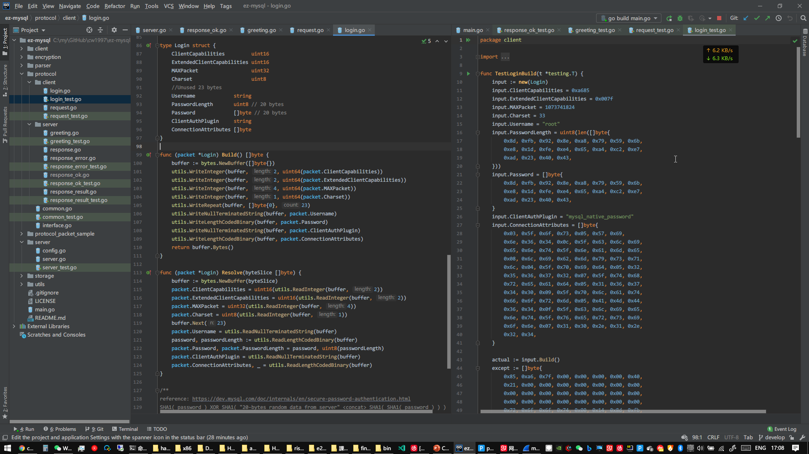
Client Login Request source code with unit test

Slide 14
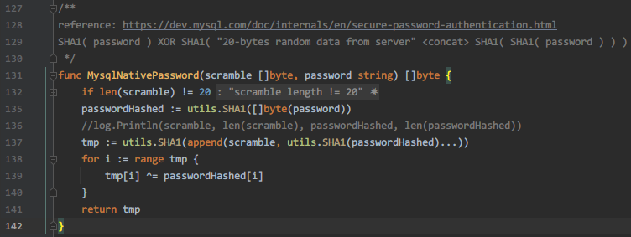
MysqlNativePassword
An Authentication Method. MySQL use the secure password plugin to verify password.
mysql_native_password is an MYSQL password plugin that is implement by CHAP(Challenge-Handshake Authentication Protocol). https://en.wikipedia.org/wiki/Chap
Use CHAP to defense replay attack, use salt to defense rainbow attack, not use cleartext password to avoid tapping by other hosts in the network when the connection without SSL.
reference: https://dev.mysql.com/doc/internals/en/secure-password-authentication.html
The password is calculated by: SHA1( password ) XOR SHA1( "20-bytes random data from server" <concat> SHA1( SHA1( password ) ) )

Slide 15
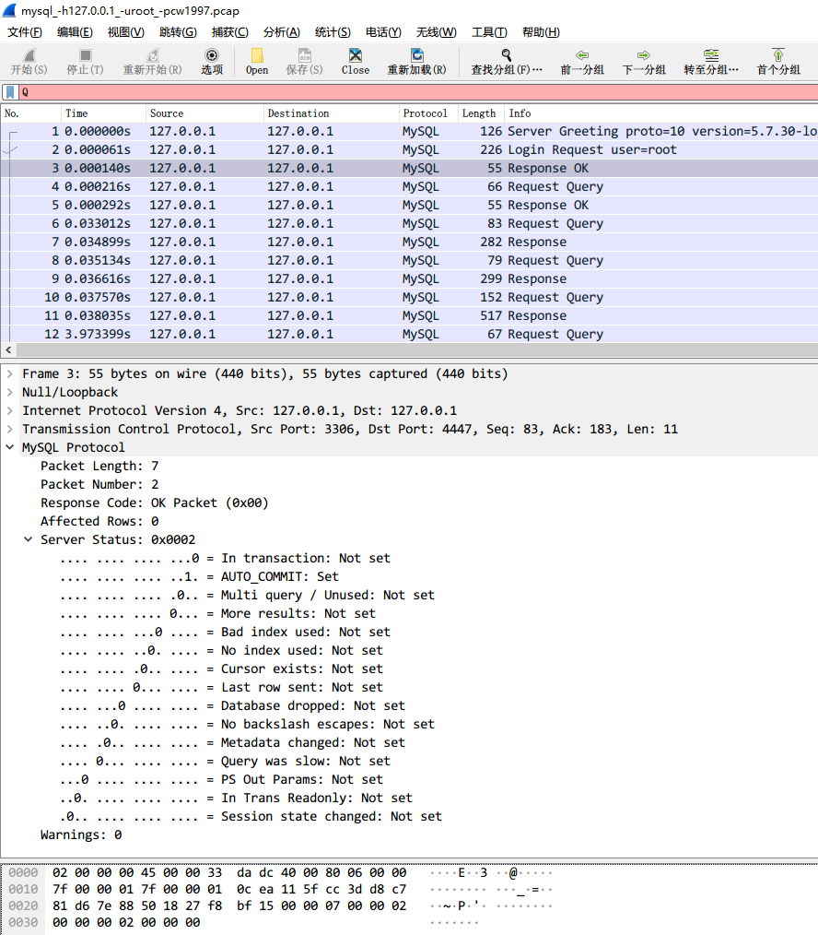
Step 3: Server Send Response OK
On this step, server sends ‘Server Status’, its length is 32bit, see the right screenshot for the description of each bit.
This package is a response packet, and Response Code is OK(0x00).

Slide 16
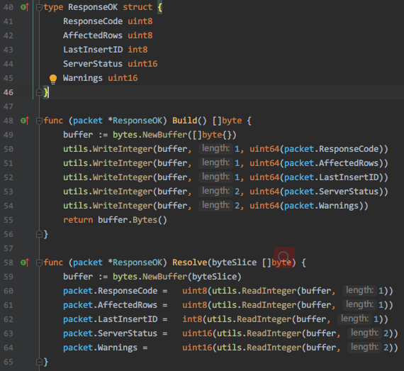
Response packet Format
Packet Length: 7
Packet Number: 1
Response Code: OK Packet (0x00)
Affected Rows: 1
Last INSERT ID: 1
Server Status: 0x0002
.... .... .... ...0 = In transaction: Not set
.... .... .... ..1. = AUTO_COMMIT: Set
.... .... .... .0.. = Multi query / Unused: Not set
.... .... .... 0... = More results: Not set
.... .... ...0 .... = Bad index used: Not set
.... .... ..0. .... = No index used: Not set
.... .... .0.. .... = Cursor exists: Not set
.... .... 0... .... = Last row sent: Not set
.... ...0 .... .... = Database dropped: Not set
.... ..0. .... .... = No backslash escapes: Not set
.... .0.. .... .... = Metadata changed: Not set
.... 0... .... .... = Query was slow: Not set
...0 .... .... .... = PS Out Params: Not set
..0. .... .... .... = In Trans Readonly: Not set
.0.. .... .... .... = Session state changed: Not set
Warnings: 0

Slide 17
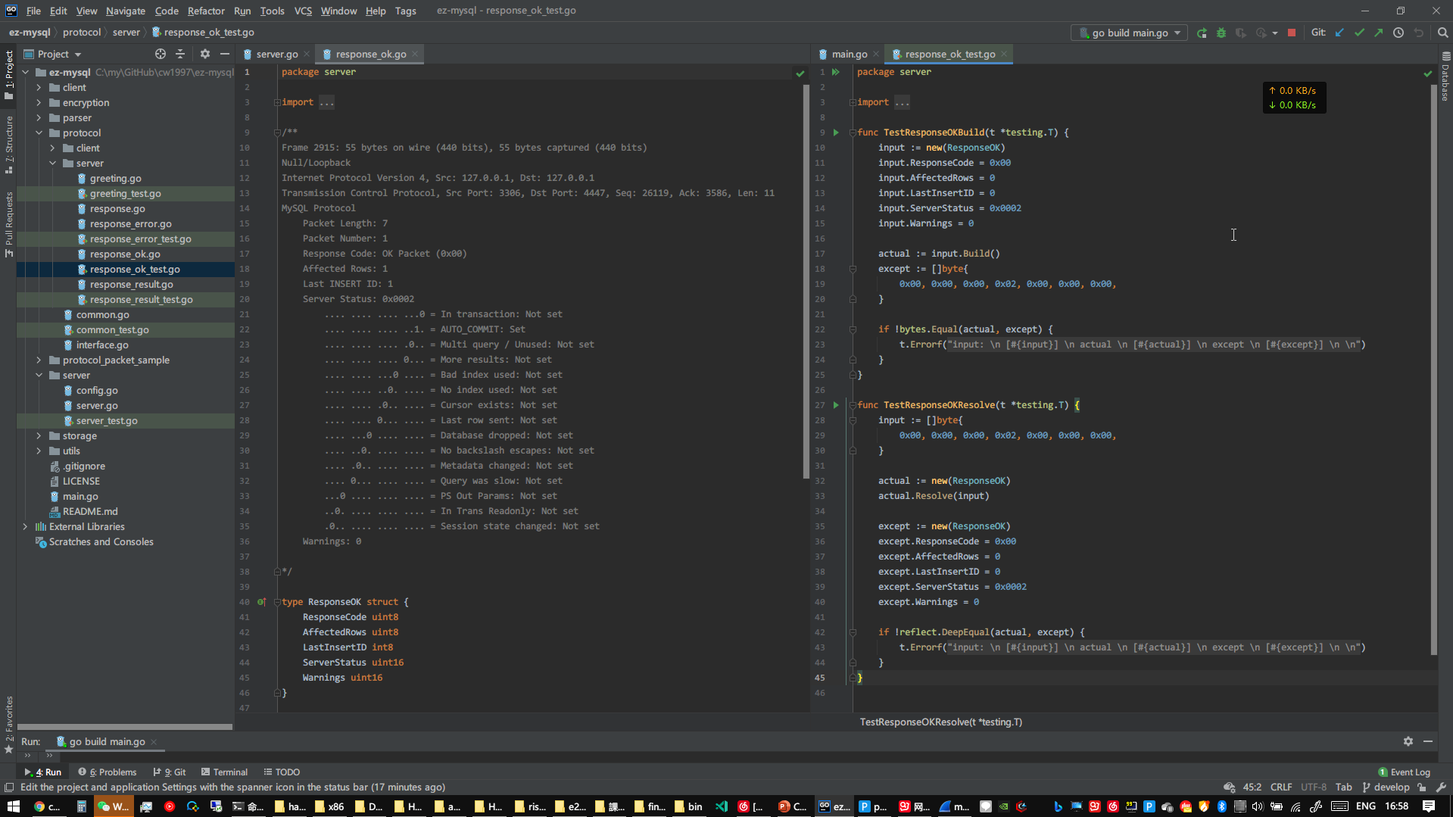
Response packet structure code and unit test code

Slide 18
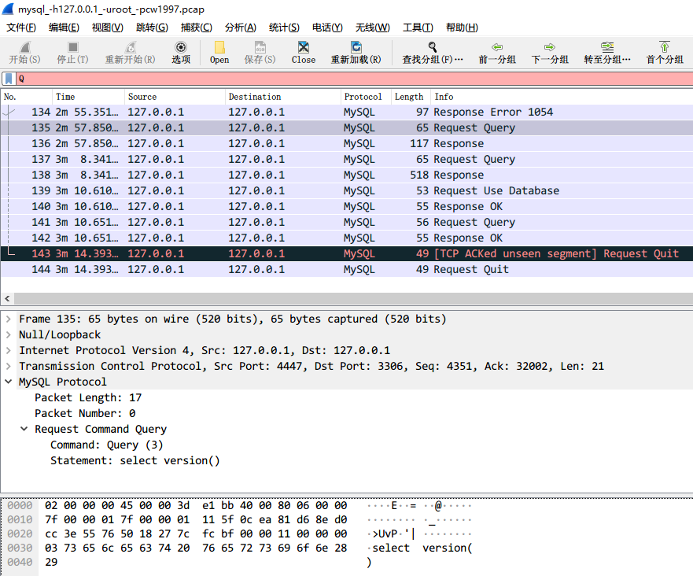
Step 4: execute SQL query statement
Send a Request packet which command is Query(0x03)

Slide 19
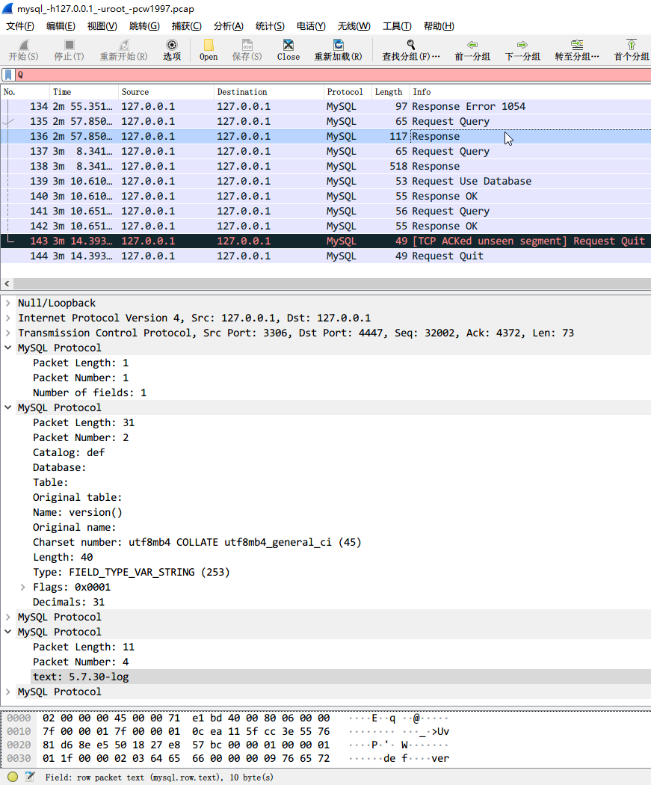
Step 5: Server return response packet
Server return the response package that number of fields number >= 0.
For every field, field name, value and EOF(end of file, response code is 0xfe) are appended to the packet.

Slide 20
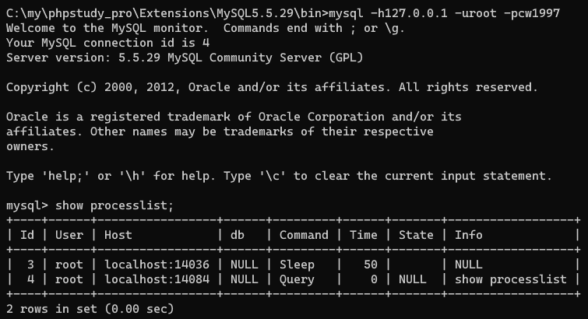
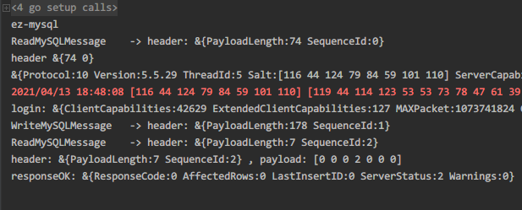
Run Client
Use ‘show processlist’ to show the clients which is connected the MySQL server.

Slide 21
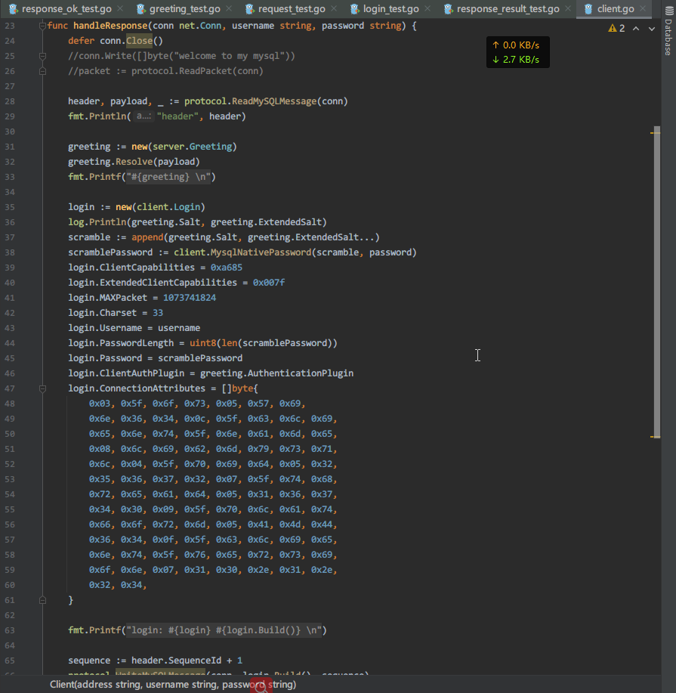
Client send login packet
See the source code, first we use salt and salt_extend from ‘server greeting packet’ to calculate the scramble.
Then we use the scramble we calculated above and the cleartext password to calculate a hash code by client.MysqlNativePassword(scramble, password) function.
Last we send the hash code for password string with username(root) and other information to the server for completing login.

Slide 22
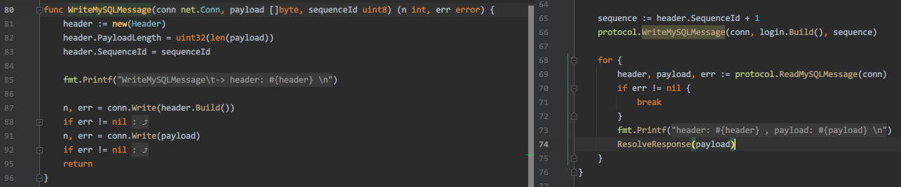
Packet header format
Before sending packet, we should build the MySQL packet header that including data payload length and sequence_id(it is auto-increment).
As the same, when we receive a MySQL packet, we should resolve the header for determine how long data size we need fetch from TCP socket buffer and the sequence_id, we need send an auto-incremented sequence_id (increment is 1) when we send a MySQL packet next time.

Slide 23
Q & A
For 3 minutes.

Slide 24

Thank you!
昌維
changwei1006@gmail.com
https://changwei.me
2021-04-13
https://changwei.me

